Slide 1
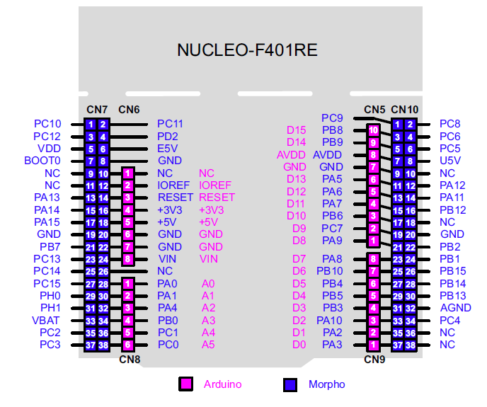
Communicating with the FT6206 (touch)
SDA – A4 PB9
SCL – A5 PB8
Alternate wiring on our boards has A4/A5 connected to PB9/PB8
Optional touch interrupt via
D4 PB5 (requires soldering)

Slide 2
SPI devices
SPI SCK – D13 PA5
SPI MISO – D12 PA6
SPI MOSI – D11 PA7
ILI9341 (LCD)
Data CS – D10 PB6
Cmd CS – D9 PC7
vs1053 (MP3) Chip
MCS – D7 PA8
DCS – D6 PB10
DREQ – D3 PB3
SD
SD CS – D4 PB5

